Slide 1


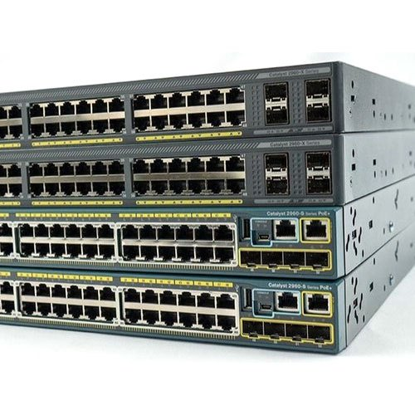
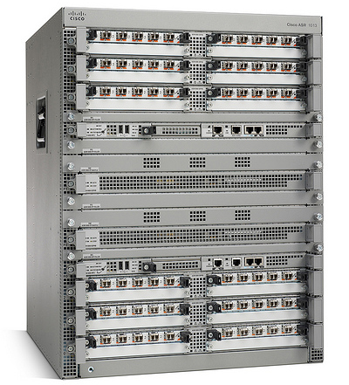
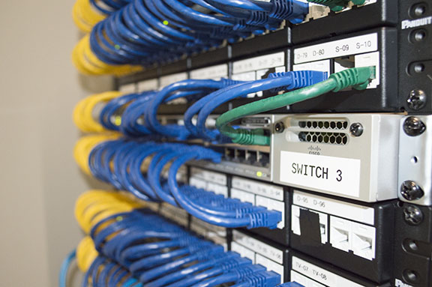


Best Tutorials for free CCNA (New!)
What is CCNA 200-301 ?
Who is this course for?
Network Fundamentals - Day 1

Slide 2
Who is this course for?
This course is for anyone...
Basically,there’s no special requirement for studying CCNA.
It is the first step in Cisco Certifications mentioned by Cisco.
Mainly, few employers prefer a Bachelor’s degree from relevant Fields like Computer science, Information Science and Engineering.
A person from both technical & non-technical background can take up the exam.

Slide 3
Who is this course for?
CCNA is one of the most respected Associate level Certification in the technological world. There are a lot of employment opportunities in this field because there are numerous technical glitches in the industry and the industries require proper and suitable solution immediately. Hence the demand for CCNA professionals is quite large.
who wants to learn about computer networking
Anyone with zero networking skills or from a non-technical background can take CCNA training and go for networking jobs.

Slide 4
What is CCNA 200-301 ?
Cisco Certification paths
CCT
Entry
Entry-level Cisco certifications begin with Cisco Certified Technician (CCT). CCT validates your ability to diagnose, restore, repair, and replace critical Cisco networking and system devices at customer sites.
Associate
CCNA , DevNet Associate
CyberOps Associate
CCNA is a well-recognized certification from Cisco a leading vendor in the field of network equipment. It is an Associate or a beginner level certification. It is globally recognized and highly respected in the industry.
Specialist
Collaboration,Data Center,Internet of Things,Customer Success
Service Provider
Business Architecture
The Technical Specialist designation certifies specific expertise of technical professionals, including those with Cisco Career certifications at the associate, professional or expert levels.

Slide 5
What is CCNA 200-301 R&S ?
Cisco Certification paths
Profession
DevNet Professional, CCNP Enterprise, CCNP Collaboration
CCNP Data Center, CCNP Security, CCNP Service Provider
This certification gives more in depth knowledge, It is for IT Professionals who have experience in networking and want to go a long way in furthering career in this field.It will also demonstrate an understanding of both video and wireless solutions as well as advanced security troubleshooting and solutions.The prerequisite of this certification is studying and passing CCNA Exam.
CCDE,CCIE Enterprise Infrastructure,CCIE Enterprise Wireless
CCIE Collaboration,CCIE Data Center,CCIE Security,
CCIE Service Provider
Expert
Cisco Certified Internetwork Expert (CCIE certification) is a series of technical certifications for senior networking professionals who design, build, implement, maintain and troubleshoot complex enterprise networking infrastructures.
Architect
CCAr
The Cisco Certified Architect (CCAr) certification is for senior network infrastructure architects who produce technical specifications for the network to support business objectives. The curriculum focuses on understanding the business strategy and translating it into technical infrastructure requirements.

Slide 6
What is CCNA 200-301 R&S ?
Cisco Certified Network Associate v1.0 (CCNA 200-301)
Duration: 120 minutes
Available languages: English, Japanese
Automation and
programmability
we will learn in this course...
Network fundamentals
New CCNA 200-301
Security fundamentals
Network access
IP services
IP connectivity

Slide 7



PRESS THE

